Slide 1

Uber
Trips
Analysis
By Amr Hagag, Ali Ahmed

Slide 2





Table of content
Introduction
EDA
Column descriptions
Counclusion
Preprocessing steps

Slide 3
Introduction
IN TODAY’S COMPETITIVE TRANSPORTATION INDUSTRY, DATA ANALYSIS PLAYS A PIVOTAL ROLE IN DRIVING BUSINESS SUCCESS. FOR A COMPANY LIKE UBER, ANALYZING TRIP DATA PROVIDES ESSENTIAL INSIGHTS THAT HELP OPTIMIZE OPERATIONS, IMPROVE THE RIDER AND DRIVER EXPERIENCE, AND GAIN A COMPETITIVE EDGE. BY STUDYING PATTERNS IN DEMAND, GEOGRAPHIC TRENDS, AND CUSTOMER BEHAVIOR, UBER CAN MAKE INFORMED DECISIONS THAT ENSURE DRIVERS ARE AVAILABLE WHEN AND WHERE THEY’RE NEEDED MOST, ULTIMATELY ENHANCING THE EFFICIENCY AND RELIABILITY OF THE PLATFORM.

Slide 4
Columns description
User_ID
User name
Driver name
Unique client
number
Uber driver
name
Client name
Car condition
Weather
Traffic condition
Car state
Weather condition
Street crowdedness

Slide 5
Columns description
Key
Fare amount
Pickup date time
Unique trip
number
Trip cost
Time when ride request
was made
Pickup longitude
Pickup latitude
Drop off longitude
Drop off latitude
Passenger count
Coordinates for
pickup point
Coordinates for
drop off point
Number of passengers
per trip

Slide 6
Columns description
Hour
Day
Month
The time of the trip
The day of the month
for the trip
The month of the trip
Week day
Year
Distance
The week day
of the trip
The year of the trip
Distance of the trip in KM

Slide 7
Columns description
jfk_dist
sol_dist
ewr_dist
nyc_dist
lga_dist
The distance between famous air ports and the starting point of the trip
Bearing
The direction of the trip from start two finish in angel

Slide 8
Preprocessing steps
Checking for Null values
Checking data types
Checking for duplicates
Dropping missing values
Dropping Costing features

Slide 9
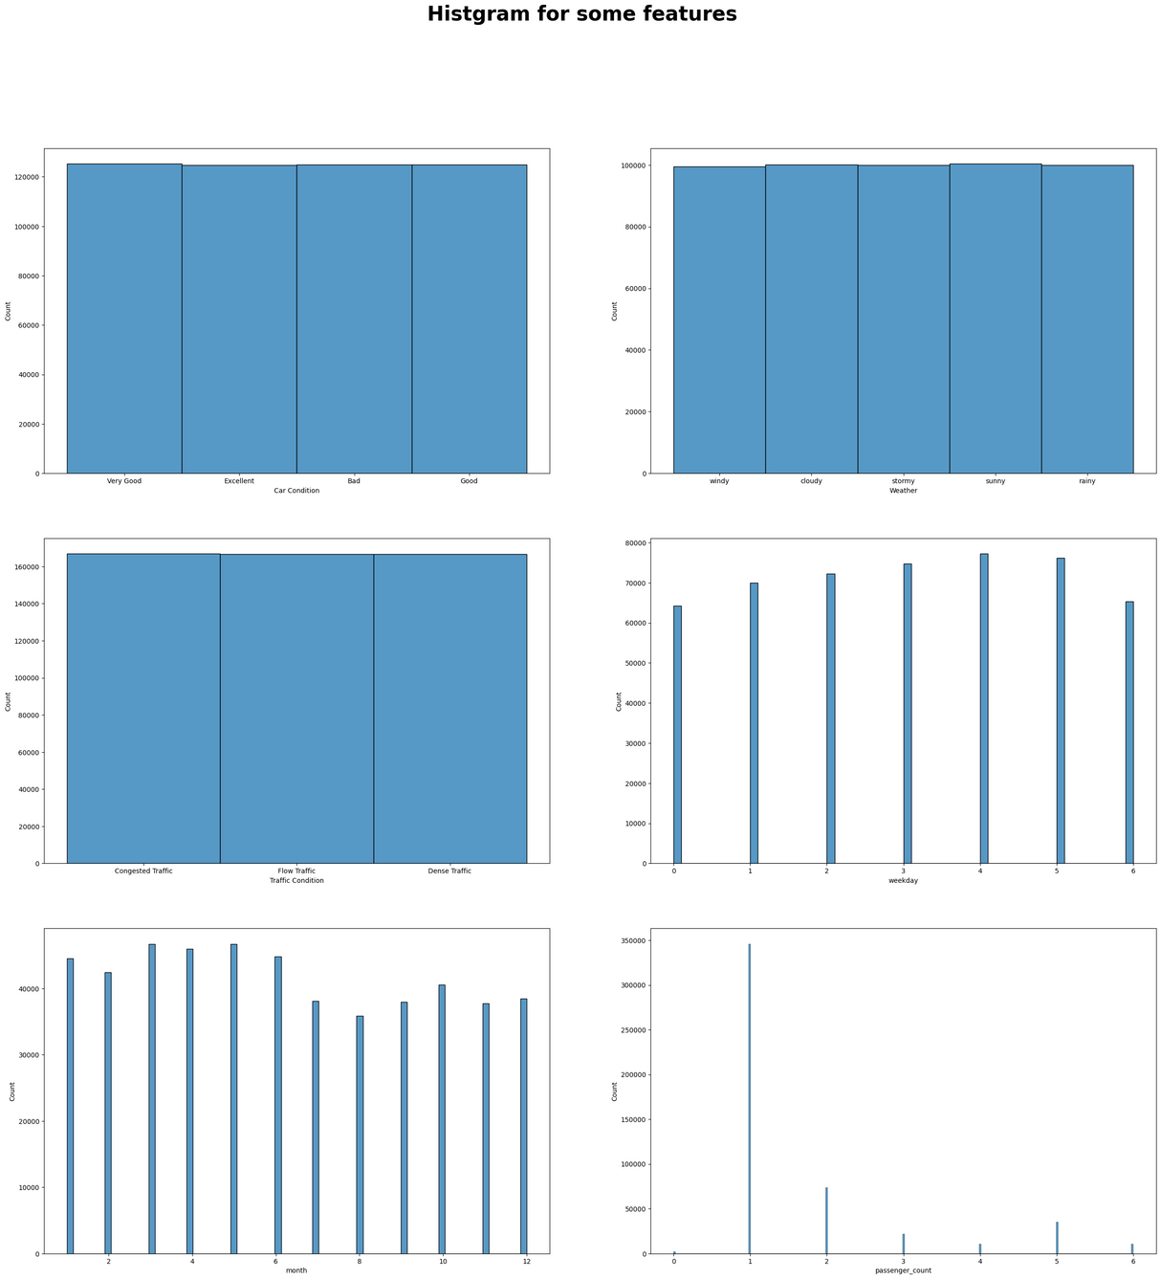
EDA
We start by plotting histogram
for some categorical features

Slide 10
EDA
Key insights
Car condition for uber drivers distribution is almost equal
weather condition distribution is almost equal
Traffic condition distribution is almost equal
Weekday distribution is almost equal
Month distribution is almost equal
In most of the trips the number of passegers is one

Slide 11
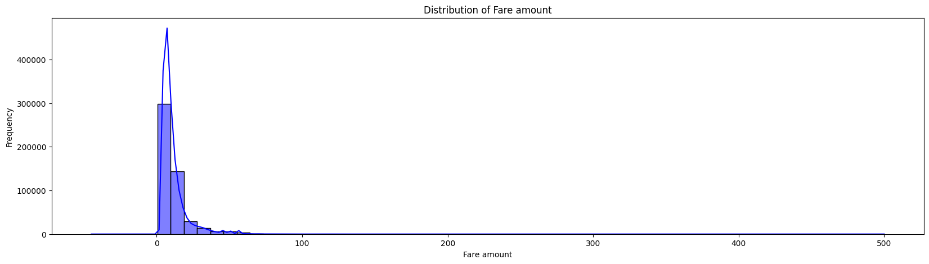
EDA
Then we plot the distribution for the fare amount
which is our target

Slide 12
EDA
Key insights
Rarely the fair for a trip exceeds 30$

Slide 13
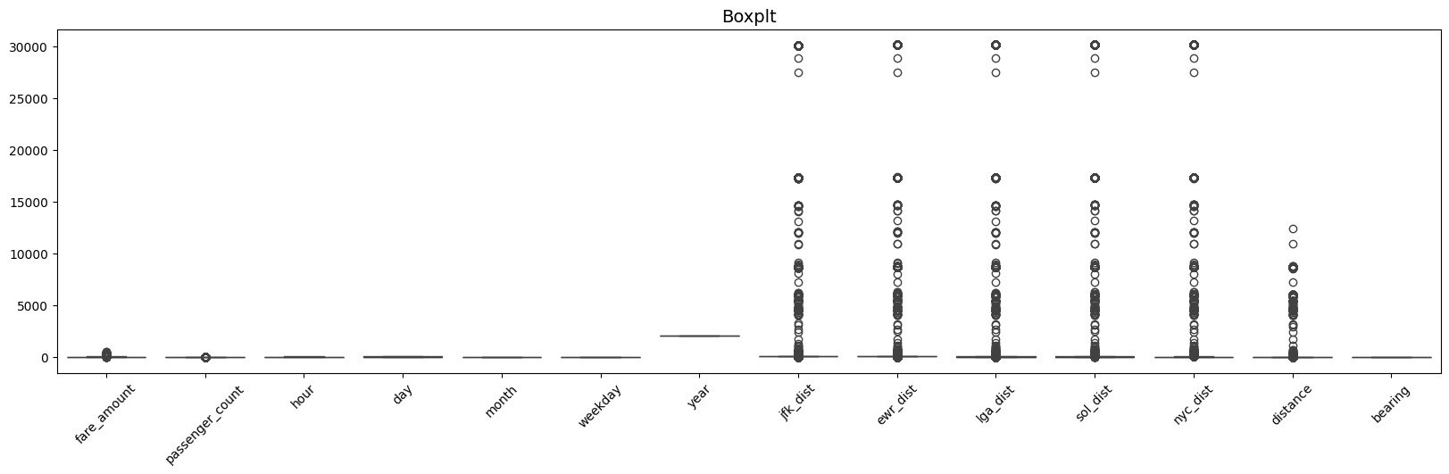
EDA
Then we plot the Box plot for the numerical features
to check for outliers

Slide 14
EDA
Key insights
Most of the outliers data are in the distances between famous airports and the starting point of the trip

Slide 15
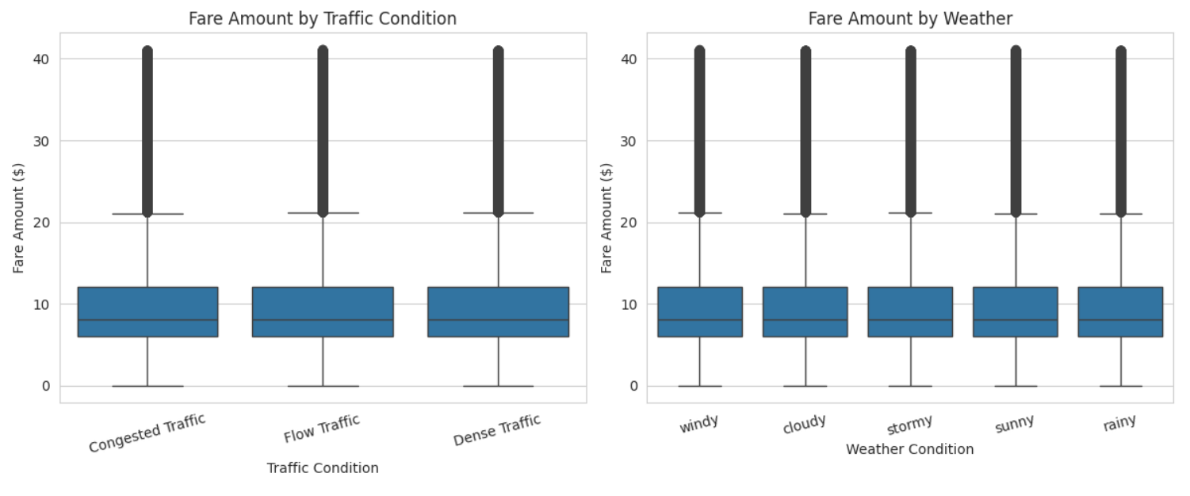
EDA
Then we plot the Box plot for fare amount against traffic condition and weather condition

Slide 16
EDA
Key insights
It appears that the fare amount is not affected by weather nor the traffic

Slide 17
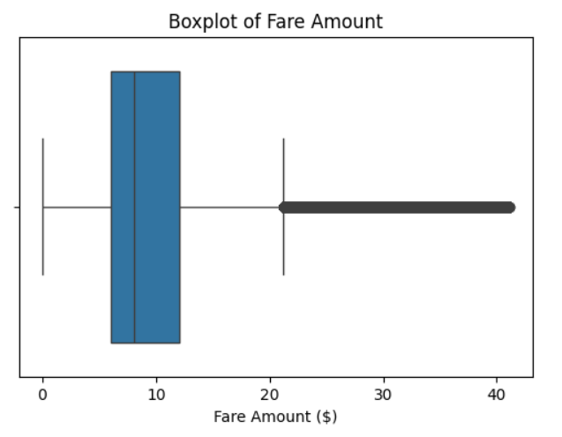
EDA
Then we plot the Box plot for fare amount

Slide 18
EDA
Key insights
It appears that most fare amounts are around 10$

Slide 19
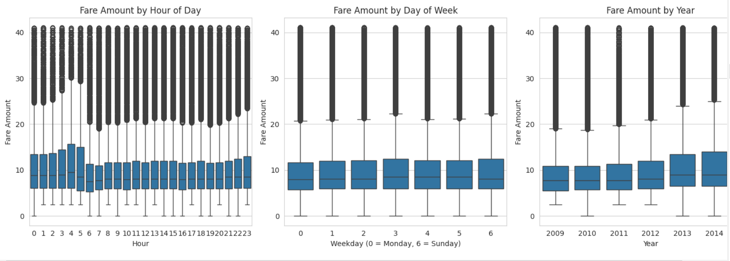
EDA
Then we plot the Box plot for fare amount against Hour – Week day - Year

Slide 20
EDA
Key insights
It appears that the rush hour is around 3 oclock

Slide 21
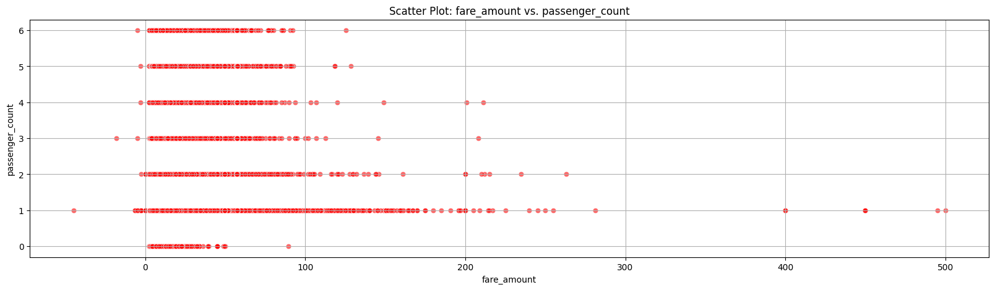
EDA
Then we make scatter plot for some features
against the fare amount first passenger count

Slide 22
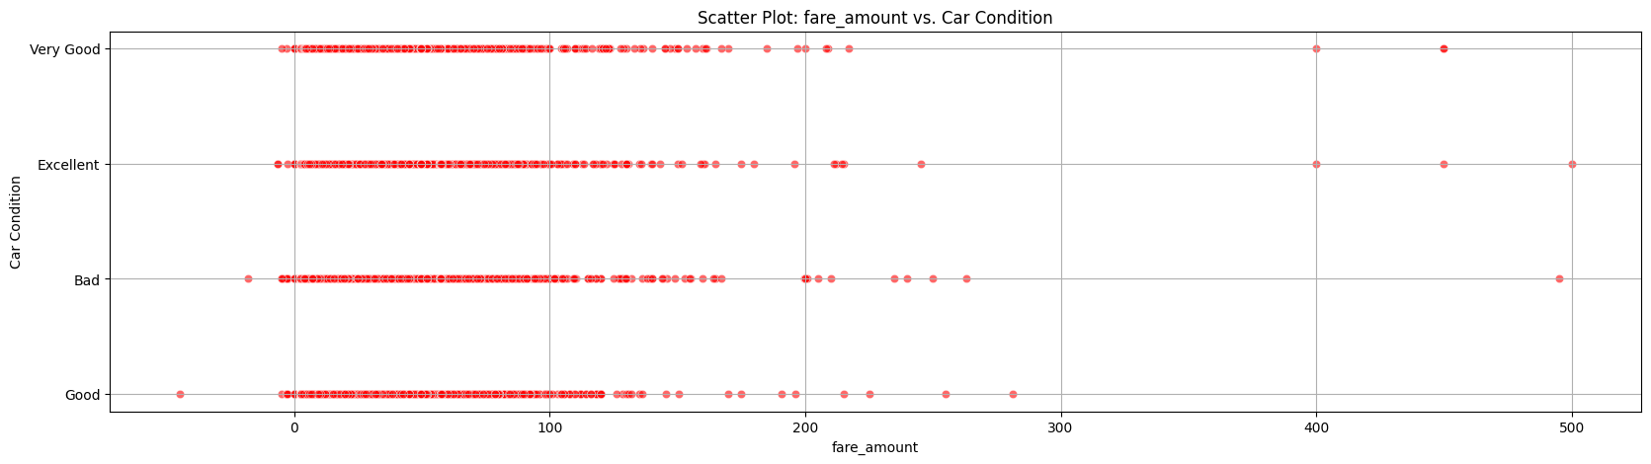
EDA
Then we make scatter plot for some features
against the fare amount second car condition

Slide 23
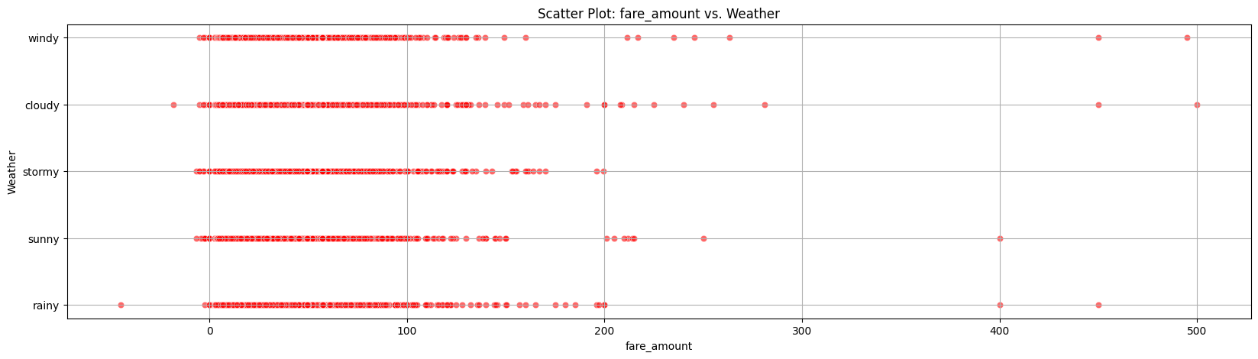
EDA
Then we make scatter plot for some features
against the fare amount third Weather

Slide 24
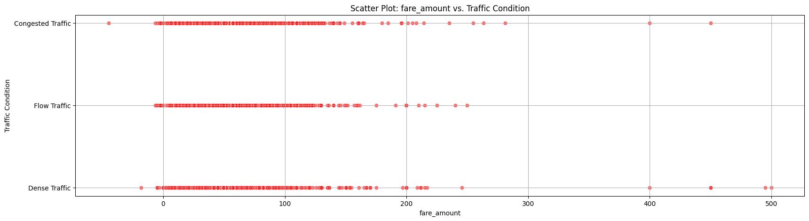
EDA
Then we make scatter plot for some features
against the fare amount forth traffic condition

Slide 25
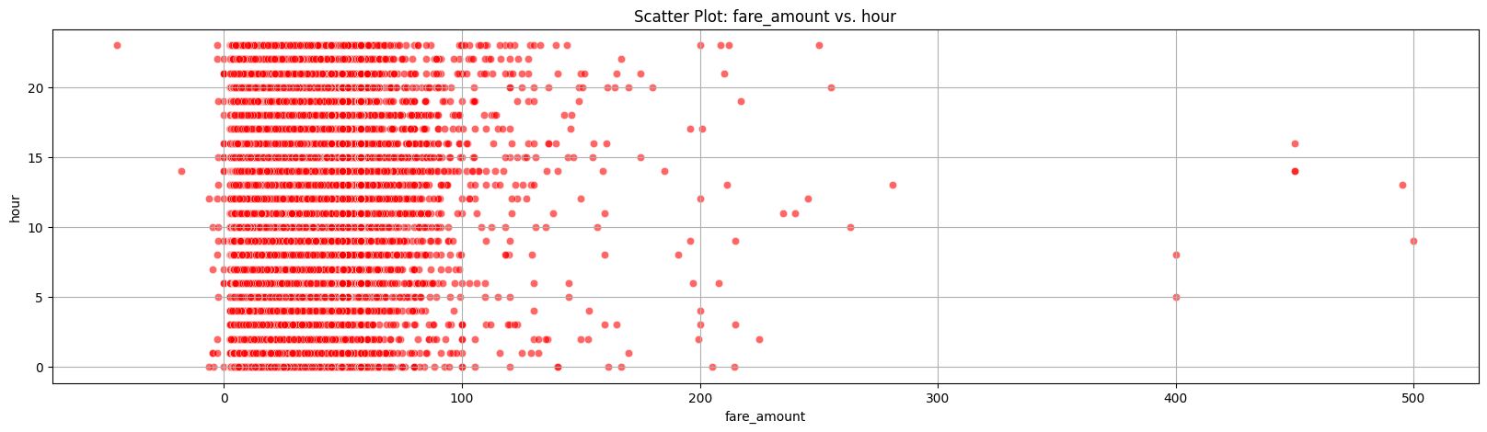
EDA
Then we make scatter plot for some features
against the fare amount fifth hour

Slide 26
EDA
Key insights
Most of high fare amount trips are made by one passenger
Car condition rarely affects the fare amount
when the weather gets cloudy or rainy the fare amount goes up
The traffic condition does not have a huge influence on fare amount
The time of the day does not affect fare amount

Slide 27
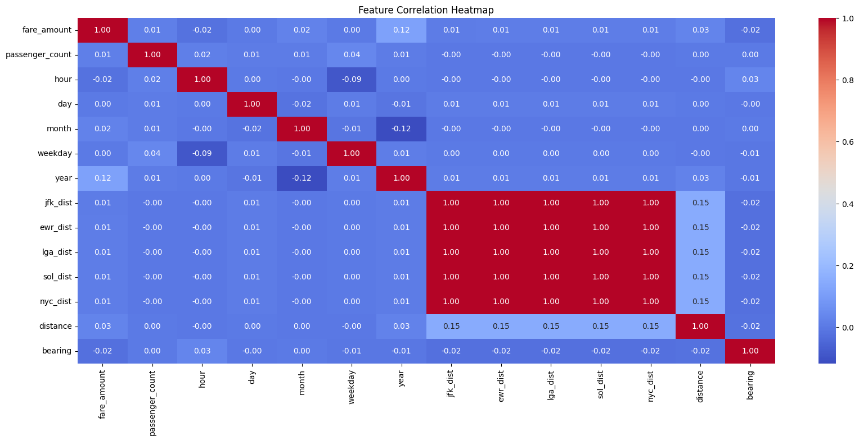
EDA
Plotting heat map to check for coloration between features

Slide 28
EDA
Key insights
It appears that distance data for famous airports are highly connected

Slide 29
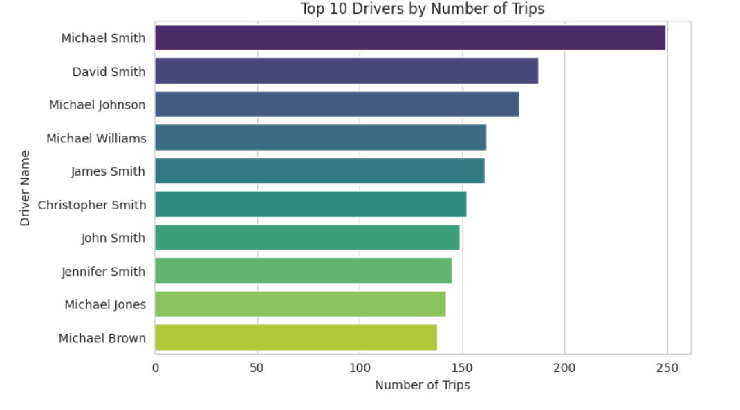
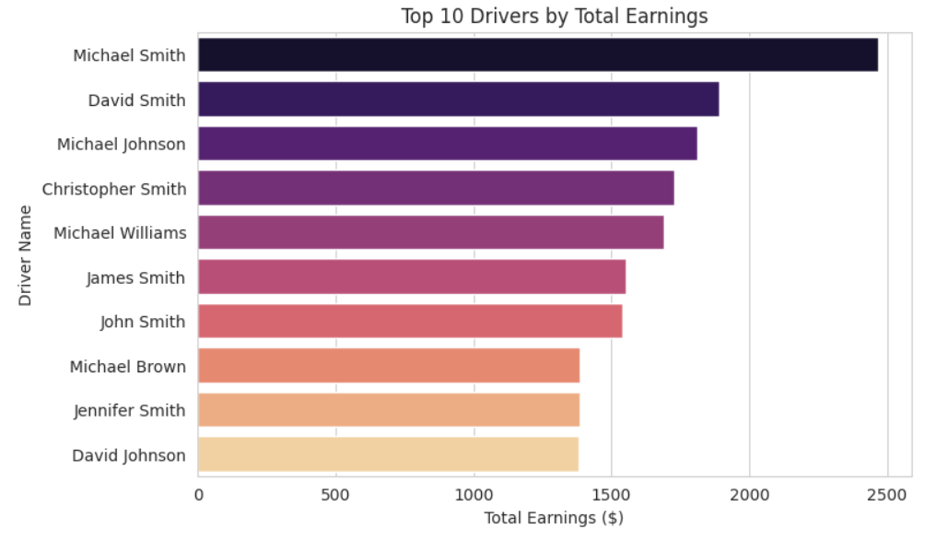
EDA
We plot the number of trips for top 10 drivers and total earning

Slide 30
EDA
Key insights
It appears that Michael Smith is the most frequent driver with the most earnings

Slide 31

Conclusion
Families or groups rarely use uber
uber application is used all year not in specific season
Even if the fare goes up when the weather gets bad customers still use uber
Uber fare changes are not high considering the time of the day or the traffic condition which is good for attracting customers

